Slide 1

Web scraping to gain company insights
14/02/2024

Slide 2

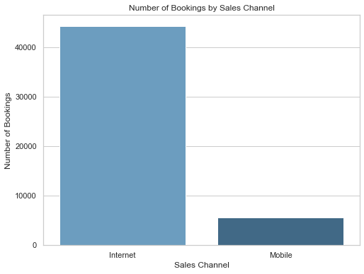
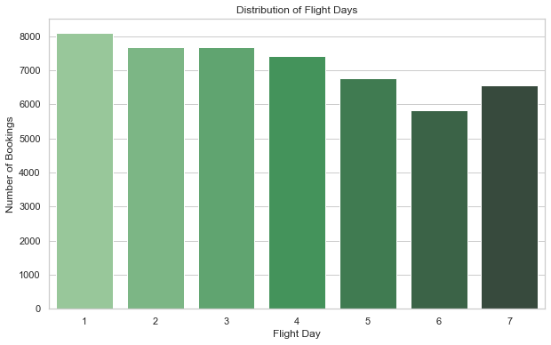
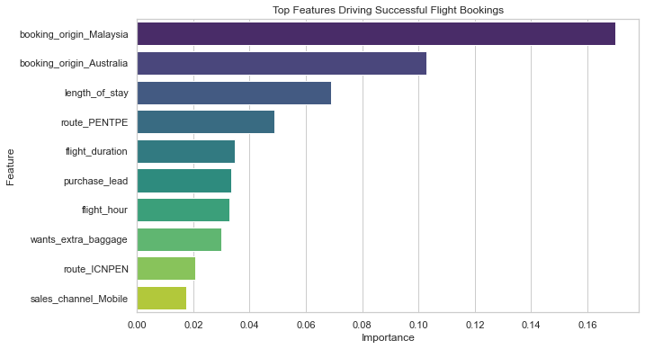
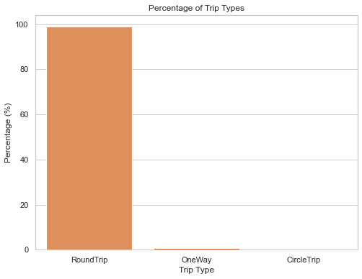
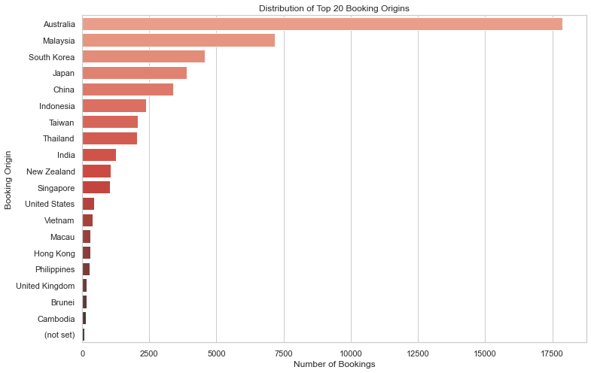
Number of bookings done through the Internet:
88.764%
Number of bookings done through the Phone Call:
11.236%
98.994%
Round Trips
0.774%
One- way Trips
0.232%
Circle Trips
Successfully Completed Bookings:
14.956%
Accuracy of Random Forest Model:
86%
Accuracy of Random Forest Model on Sample data:
50%
We are concerned with not predicting the successful bookings correctly. Imbalance dataset drives higher accuracy but it does not accurately predict the successful bookings.
The dataset was balanced with 8k labelled as incomplete bookings and 7k as complete bookings.

